Slide 1


Automotive Data Pipeline
Data Engineer - Assessment
Diogo Gomes

Slide 2

Contents
1
Introduction
2
Architecture & Data Acquisition
3
Data Processing & Transformation
4
Loading Strategy & Automation
5
Results, Validation & Data Quality
6
Conclusion & Next Steps

Slide 3

Introduction
The automotive industry increasingly relies on data to monitor safety, performance and infrastructure trends
This assessment focuses on building an end-to-end pipeline for publicly available datasets
The goal is to automate acquisition, cleaning, transformation and simulate loading of vehicle-related datasets
The pipeline supports analysis of safety complaints, fuel economy and alternative fuel infrastructure
Notes:
Good morning, and thank you for reviewing my assessment.
In this project, the goal was to work with publicly available automotive datasets and build a complete data pipeline around them. Today, the automotive industry increasingly depends on data to monitor safety trends, energy efficiency, and infrastructure development.
For this assessment, I focused on three key datasets:
NHTSA vehicle safety complaints,
DOE alternative fuel stations,
and EPA fuel economy data.
The idea was to automate the acquisition of these datasets, process and clean them, integrate them into a single analytical view, and simulate how they would be loaded into a target system such as Azure Delta Lake.
This presentation walks through the full pipeline and the reasoning behind each step.

Slide 4

Objectives
Build an end-to-end pipeline to ingest, clean, transform
Prepare the data for downstream analysis and insights
Simulate loading the final datasets into a target storage system (Azure Delta Lake)
Document Key Decisions made during processing and transformation
Propose an automation strategy with a suitable schedule
Notes:
The assessment defined five main objectives, and I structured the entire pipeline around them.
Data Acquisition — Create scripts to automatically download and ingest the three public datasets.
Data Processing — Clean, normalize, and standardize each dataset, handling missing values, duplicates, and inconsistent formats.
Data Transformation — Join the datasets into a single integrated model, creating meaningful metrics such as aggregated complaints and vehicles-per-station.
Data Loading (Simulation) — Prepare the final output as if it were being loaded into Azure SQL or a Databricks Delta Lake environment.
Automation Strategy — Propose how this pipeline could run automatically on a schedule, with monitoring and validation steps.
These objectives guided each design decision, from the architecture to the cleaning logic to the final output.

Slide 5









Architecture & Data Flow
Data Acquistion: NHTSA, DOE and EPA Datasets
Data Processing: Cleaning, normalize and schema alignment
Data Transformation:
Aggregation, joining and feature creation
Load Simulation & Automation Layer:
Loading simulation into Azure Delta Lake structure & a simple simulated weekly orchestration
Notes:
This is the high-level architecture of the pipeline I implemented for the assessment.
The pipeline begins with the Data Acquisition layer, where each of the three datasets — NHTSA complaints, DOE alternative fuel stations, and EPA fuel economy — is ingested through dedicated scripts. The acquisition process handles different formats, such as CSV and JSON, and ensures the raw data is stored in a reproducible way.
From there, the data moves into the Processing layer. Here, I perform all the core data cleaning steps: removing duplicates, standardizing text fields like vehicle make and model, converting data types, and aligning schemas where needed. Each dataset is cleaned independently so it can be reliably integrated later.
The next step is the Transformation layer, where the datasets are combined into a single analytical model. This includes computing aggregated metrics, such as the total number of complaints per vehicle configuration, and calculating indicators like vehicles-per-station based on fuel type. This is also where I unify naming conventions and ensure referential consistency.
After producing the final integrated dataset, I simulate the Loading layer, preparing the data as if it were being inserted into Azure SQL or a Databricks Delta Lake environment. Even though the assessment does not require a real load, the script generates the exact commands and structure that would be used in production.
Finally, I define the Automation layer, which describes how the entire workflow could be scheduled, monitored, and retried in a tool like Azure Data Factory, orchestrating each step of the pipeline.
This architecture keeps each layer isolated, makes the pipeline easy to maintain, and ensures that the entire flow can be automated in a real-world scenario.”

Slide 6
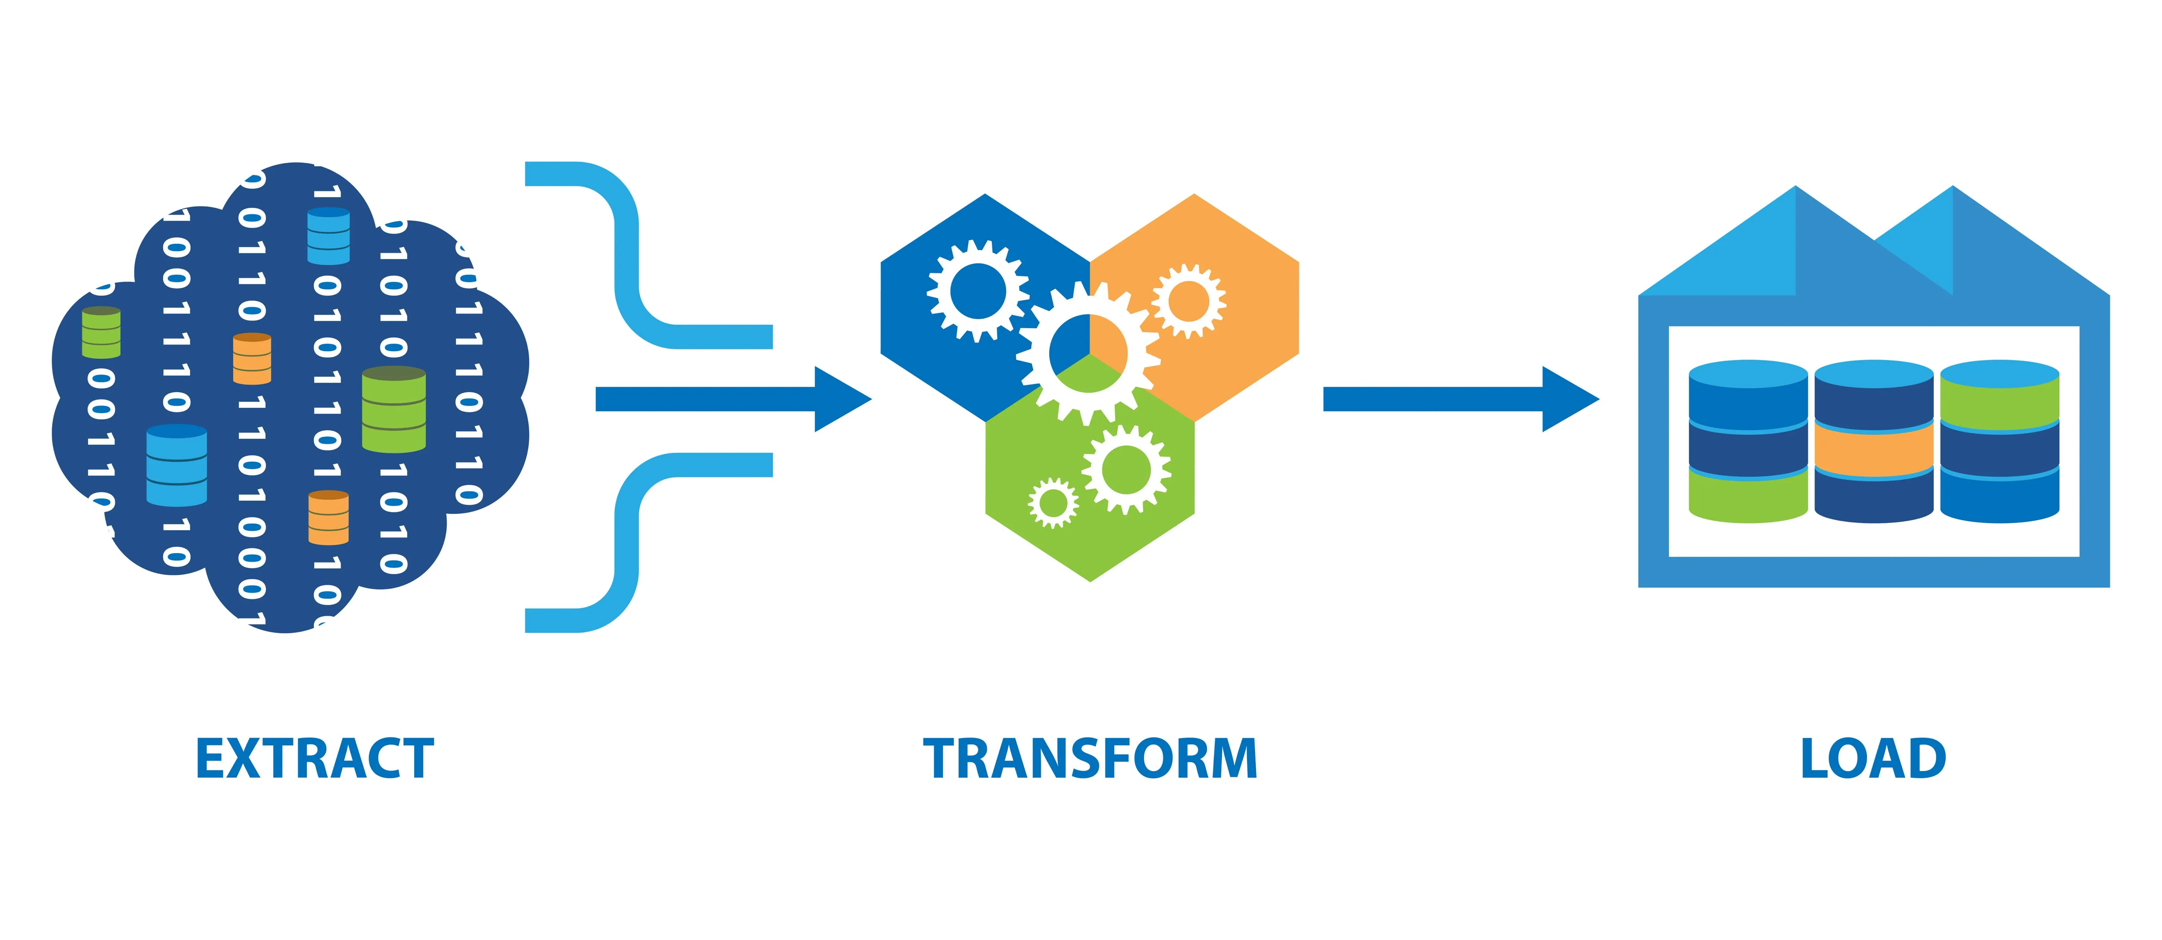
Data Sources
Source | Format | Key Fields
NHTSA Complaints | TSV (bulk) | Make, Model, Year, Component, Crash, Fire, Injured, Deaths, Complaint ID
DOE Alt Fuel Stations | API JSON→CSV | Fuel_Type_Code, Station_Name, State, Latitude, Longitude, Status
EPA Fuel Economy | CSV (bulk) | Make, Model, Year, Fuel Type, MPG, CO2, Cylinders, Transmission
Notes:
Before diving into the acquisition layer, here is a quick overview of the datasets used in the pipeline. The first dataset comes from NHTSA and contains detailed vehicle safety complaints in CSV format. The second dataset comes from the Department of Energy, provided through a JSON API containing alternative fuel station data. And the third dataset is the EPA fuel economy dataset, also in CSV, which includes efficiency and emissions fields. These three sources complement each other and form the foundation of the integrated analytical model built in the pipeline.

Slide 7
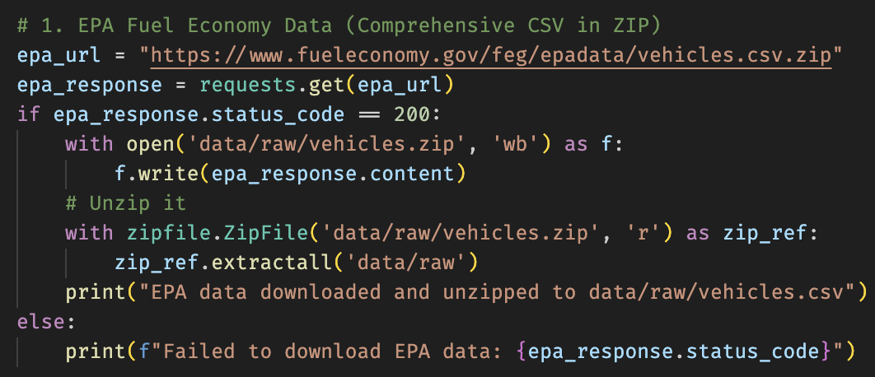
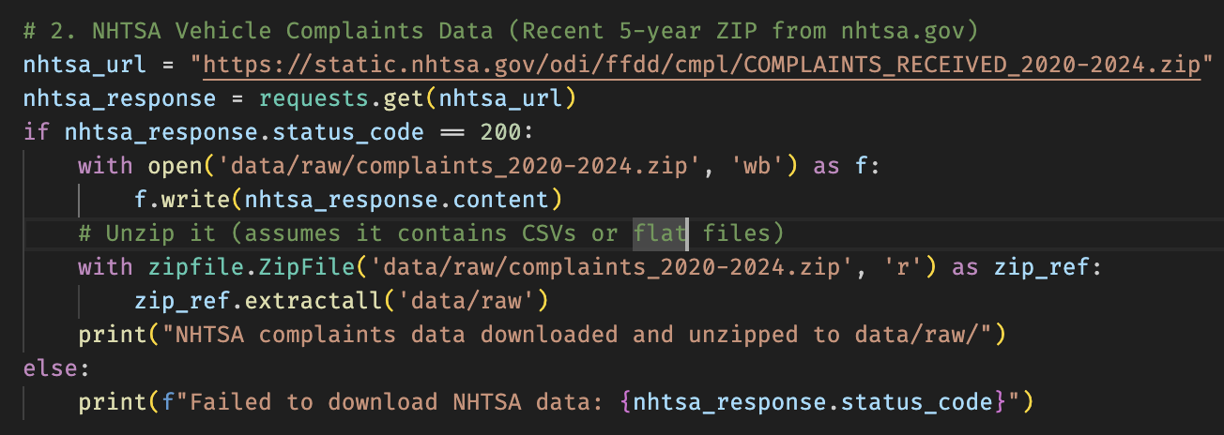
Data Acquisition – Extract Phase
Single Acquisition Script
acquire_data.py downloads all three sources into data/raw
EPA – Fuel Economy (vehicles)
Download ZIP from fueleconomy.gov
Save as data/raw/vehicles.zip and unzip to data/raw
NHTSA – Vehicles Complaints (2020-2024)
Download ZIP from nhtsa.gov
Save as data/raw/complaints_2020-2024.zip and unzip to data/raw
Notes:
Before diving into the acquisition layer, here is a quick overview of the datasets used in the pipeline. The first dataset comes from NHTSA and contains detailed vehicle safety complaints in CSV format. The second dataset comes from the Department of Energy, provided through a JSON API containing alternative fuel station data. And the third dataset is the EPA fuel economy dataset, also in CSV, which includes efficiency and emissions fields. These three sources complement each other and form the foundation of the integrated analytical model built in the pipeline.

Slide 8
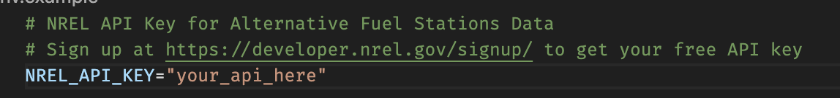
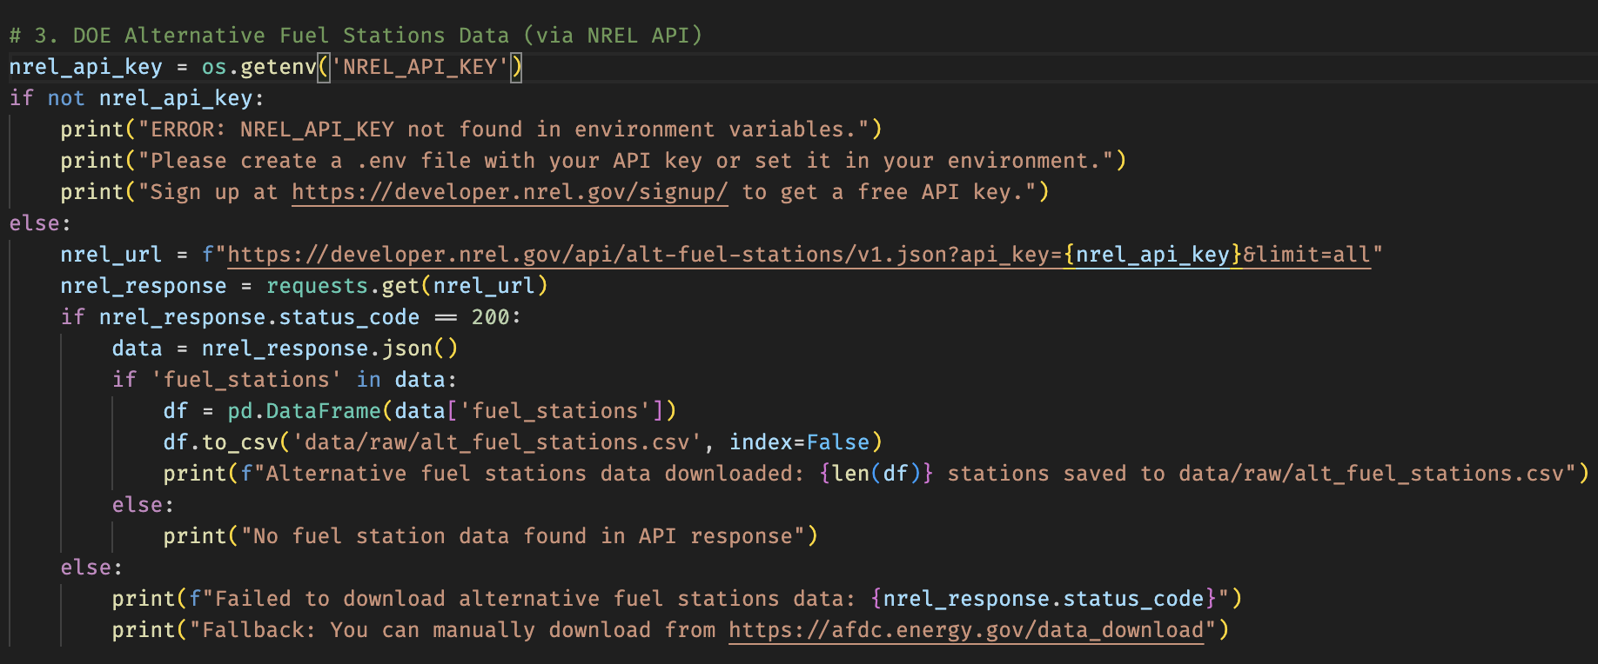
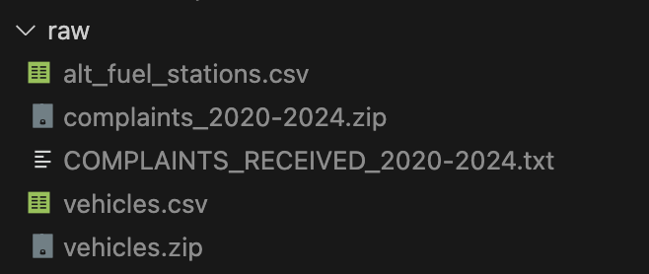
Data Acquisition – Extract Phase
DOE – Alternative Fuel Stations (NREL API)
Read NREL_API_KEY from .env using python-dotenv
Call NREL API (alt-fuel-stations/v1.json?limit=all)
Convert JSON → pandas.DataFrame → data/raw/alt_fuel_stations.csv
Notes:
The data acquisition is handled by a single Python script that ingests all three datasets into a raw data layer.
First, the script ensures the folder data/raw exists, so every run writes files to a consistent location.
For the EPA fuel economy data, I download the ZIP file from fueleconomy.gov, save it as vehicles.zip, and then use Python’s zipfile module to extract it into data/raw/vehicles.csv. This gives me a comprehensive table of vehicles, fuel types, and fuel economy metrics.
For the NHTSA vehicle complaints, I follow the same pattern: I download the ZIP file containing complaints from 2020 to 2024, save it under data/raw/complaints_2020-2024.zip, and unzip all its contents into the raw folder. That produces a large flat file with all the complaints that will be cleaned in the next step.

Slide 9
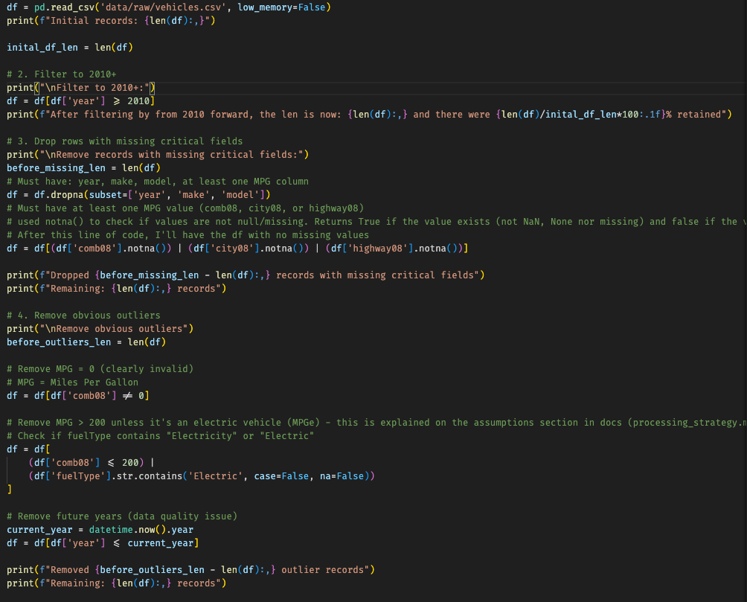
Data Processing – Cleaning & Preparation
EPA Vehicles – Processing & Dual-Fuel Handling
Initial filtering & basic cleaning
Load vehicles.csv, keep model years ≥ 2010
Drop rows missing year, make, or model
Require at least one MPG value (comb08 / city08 / highway08)
Outlier & quality filters
Remove comb08 = 0 (invalid MPG)
Cap comb08 at ≤ 200, except for electric / “Electricity” entries
Remove vehicles from future years (greater than current year)
Column reduction & renaming
Reduce from 84 columns to a focused subset (year, make, model, class, engine, MPG, CO₂, etc.)
Keep fuelType1 and fuelType2 for dual-fuel handling
Rename to primary_fuel and secondary_fuel
Notes:
Now let me walk you through how I processed the EPA vehicle dataset, which is the largest and richest of the three sources.
We start with the full vehicles.csv file directly from the EPA. It contains more than 80 columns with every vehicle the EPA has published, so the first step is applying structured filtering.
I begin by restricting the dataset to model years 2010 and above. The reason for choosing 2010 is that fuel technology, emissions standards, and vehicle classification are much more consistent from 2010 onward, so this gives us a cleaner and more reliable analytical baseline.
Next, I remove rows missing key fields such as year, make, or model, and I also ensure that the vehicle has at least one meaningful fuel-economy metric — whether combined, city, or highway MPG. Vehicles with no MPG data at all simply cannot be used in consumption or emissions analysis, so they are safely removed here.
After that, I apply outlier logic. Any vehicle with a combined MPG of zero is invalid and removed. And gasoline or diesel vehicles with MPG values over 200 are clearly errors — but electric vehicles are an exception because MPGe values can legitimately go above 100, so the filter accounts for that by checking the fuel type.
I also exclude vehicles from future years, which appear occasionally due to data entry issues. All of these steps together significantly improve data consistency and avoid misleading results later on.
Once the dataset is clean, I reduce the number of columns from over 80 to a focused subset containing only the variables relevant to this assessment — such as vehicle class, engine displacement, cylinders, transmission, CO₂ output, and the fuel types. I also rename the fuel columns to primary_fuel and secondary_fuel so they are semantically meaningful for the next stage.
And finally, the most important part of this dataset is the dual-fuel handling. Instead of keeping one row per vehicle, I transform it into one row per fuel that vehicle can use. This ensures that plug-in hybrids and flex-fuel vehicles are represented accurately in the fuel-infrastructure analysis later.
I'll explain this transformation visually on the next slide.

Slide 10
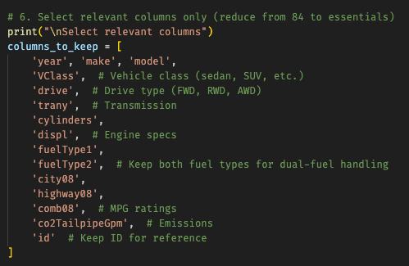
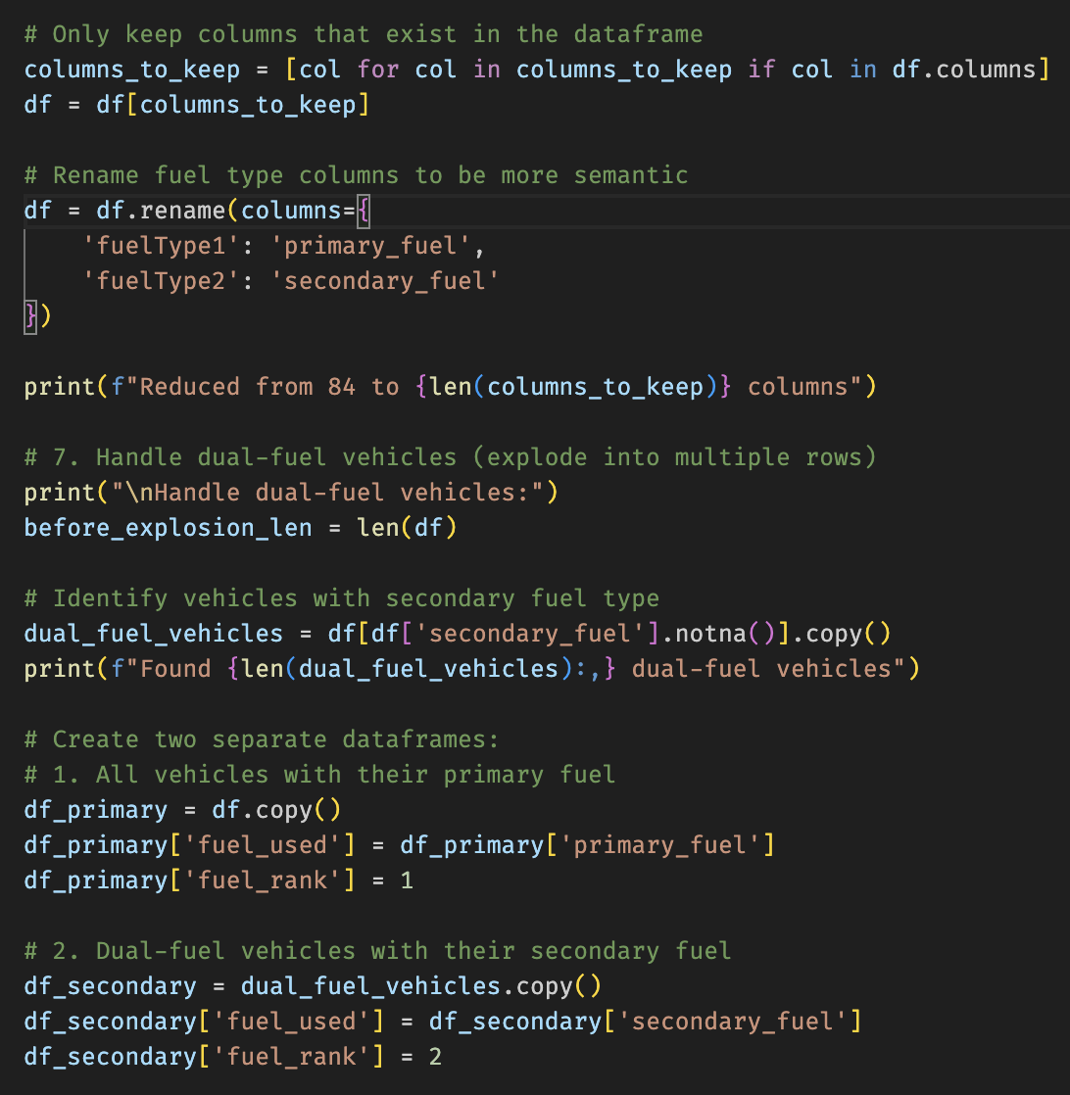
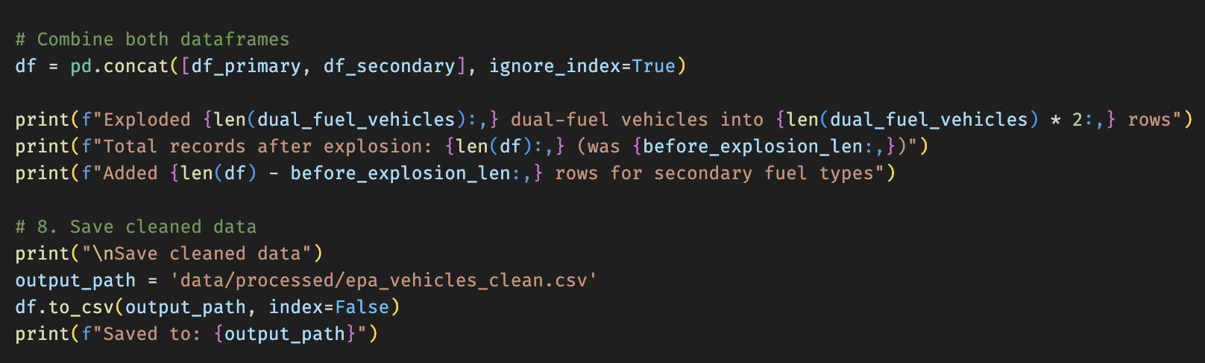
Data Processing – Cleaning & Preparation
EPA Vehicles – Processing & Dual-Fuel Handling
Dual-fuel explosion
Identify vehicles with secondary_fuel not null
Build:
df_primary: fuel_used = primary_fuel, fuel_rank = 1
df_secondary: fuel_used = secondary_fuel, fuel_rank = 2
Concatenate into final dataset: rows represent vehicle–fuel combinations
Save to data/processed/epa_vehicles_clean.csv
Notes:
One of the biggest complications when working with the EPA data is how dual-fuel vehicles are represented. In the raw dataset, vehicles like plug-in hybrids or flex-fuel trucks are stored as a single row, with two columns: fuelType1 and fuelType2.
But that representation creates a major issue when we try to analyze infrastructure needs. For example, a plug-in hybrid like a Chevrolet Volt uses gasoline as the primary fuel, but it also depends on electricity for charging. If we leave the dataset as one row, that Volt would be counted only as a gasoline vehicle and completely ignored in EV charging demand calculations. The same thing happens with ethanol flex-fuel vehicles.
So instead of leaving the structure as-is, I ‘explode’ these vehicles into multiple rows — one for each fuel the vehicle supports.
On the left of the diagram you can see the raw EPA row: a single vehicle with fuelType1 = Gasoline and fuelType2 = Electricity.
During processing, this becomes two rows. The first row represents the vehicle using gasoline as its fuel, with fuel_used = primary_fuel and fuel_rank = 1. The second row represents the same physical vehicle using its secondary fuel, so fuel_used = Electricity and fuel_rank = 2.
Both rows still contain all the context — make, model, emissions, engine, vehicle class — so we never lose information about the vehicle. We simply create a structure where counting vehicles by fuel type becomes accurate and straightforward.
This means that when later I compute CHARGING demand, or E85 infrastructure, or gasoline-based emissions, plug-in hybrids and flex-fuel vehicles are properly included. Without this step, every fuel-type distribution in the results would be wrong.
This approach increases the row count slightly, but it produces a much more correct analytical dataset, and it prevents subtle but serious misclassifications in the final insights.

Slide 11
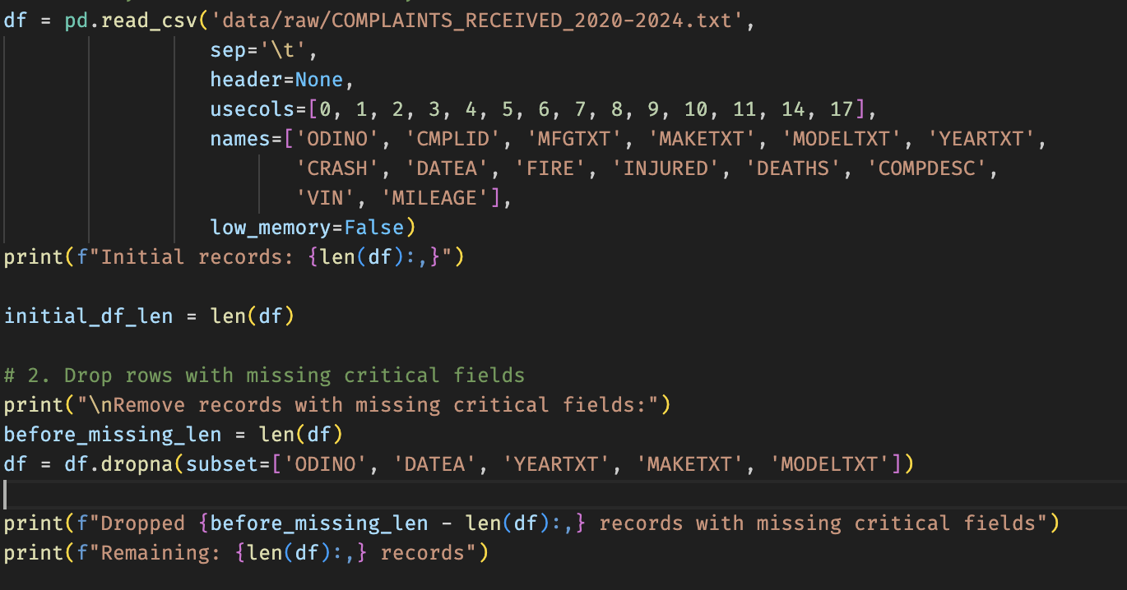
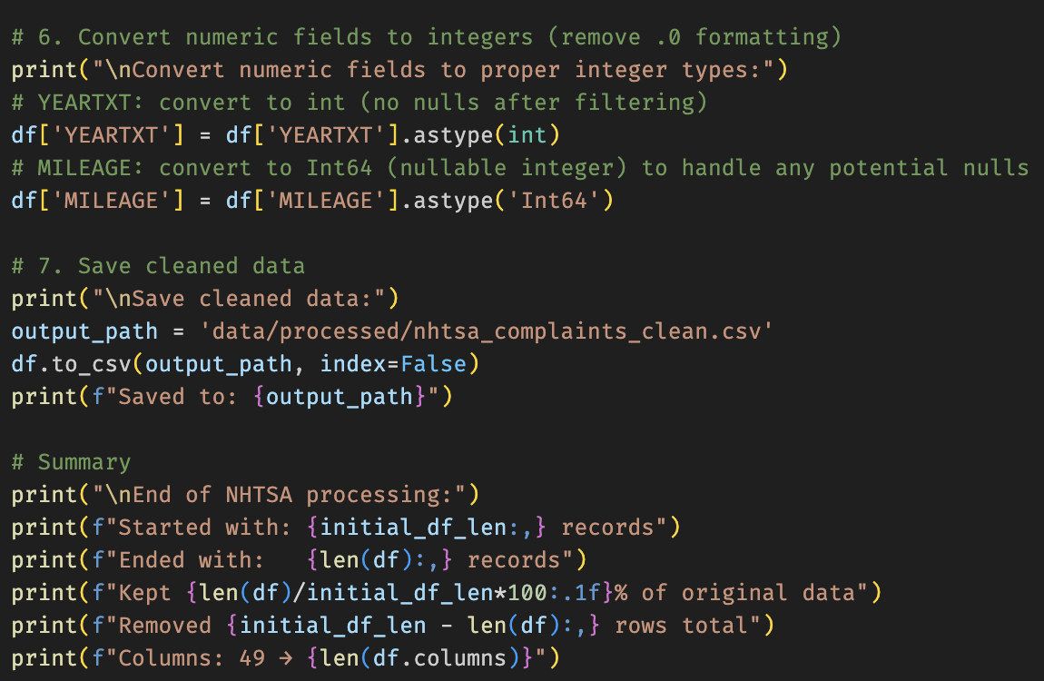
Data Processing – Cleaning & Preparation
NHTSA Complaints – Processing & Cleaning
Raw file characteristics
Flat text file (.txt) with no header row
Tab-separated (\t)
Columns selected by position and renamed:
ODINO, CMPLID, MFGTXT, MAKETXT, MODELTXT, YEARTXT, CRASH, DATEA, FIRE, INJURED, DEATHS, COMPDESC, VIN, MILEAGE
Critical filters & basic cleaning
Drop rows missing: ODINO, DATEA, YEARTXT, MAKETXT, MODELTXT
Parse DATEA (YYYYMMDD → datetime)
Convert YEARTXT to numeric
Outlier & quality rules
Remove future dates and future vehicle years
Cap MILEAGE at ≤ 1,000,000 miles (data entry error filter)
Deduplication & final formatting
Drop exact duplicates on ODINO
Convert DATEA back to YYYY-MM-DD string
Cast YEARTXT to int and MILEAGE to nullable Int64
Save as data/processed/nhtsa_complaints_clean.csv
Notes:
Now I’ll go through how I cleaned the NHTSA complaints dataset.
The raw file is a large tab-separated text file with no header row, so the first step was to manually inspect the layout and then explicitly select only the columns I needed by position. I map those positions to meaningful names like ODINO, MAKETXT, MODELTXT, YEARTXT, DATEA, INJURED, DEATHS, and MILEAGE. This makes the dataset much easier to work with downstream.
Next, I remove rows that are missing critical information. In particular, I require a complaint ID, an event date, a vehicle year, and the make and model. Without those fields, the record can’t be reliably linked to a vehicle, so those rows are dropped.
Then I handle the data types and outliers. I convert the DATEA column from the raw YYYYMMDD format into a proper datetime type, and I convert YEARTXT to a numeric year. With those types in place, I can safely remove complaints that are dated in the future, as well as vehicle years that are beyond the current calendar year. I also apply a simple sanity check on mileage: any complaint with a mileage greater than one million miles is treated as a data entry error and filtered out.
After these quality checks, I remove exact duplicates based on the ODINO field, which uniquely identifies a complaint. This ensures that if the same complaint appears more than once in the source file, it is only counted once in the analysis.
Finally, I convert DATEA back into a clean string in YYYY-MM-DD format for CSV storage, cast YEARTXT to int, and store MILEAGE as a nullable integer type so missing values are preserved correctly. The cleaned result is written to data/processed/nhtsa_complaints_clean.csv, and this becomes the trusted source for all later aggregations and joins.
Overall, the goal here is not to over-engineer the logic, but to make sure the complaints dataset is structurally sound, typed correctly, and uniquely keyed before it is integrated with the EPA vehicles

Slide 12
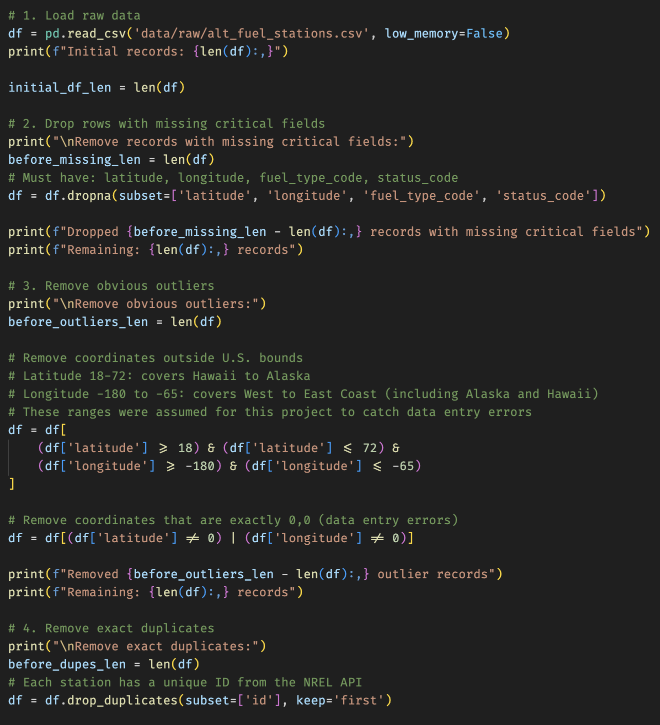
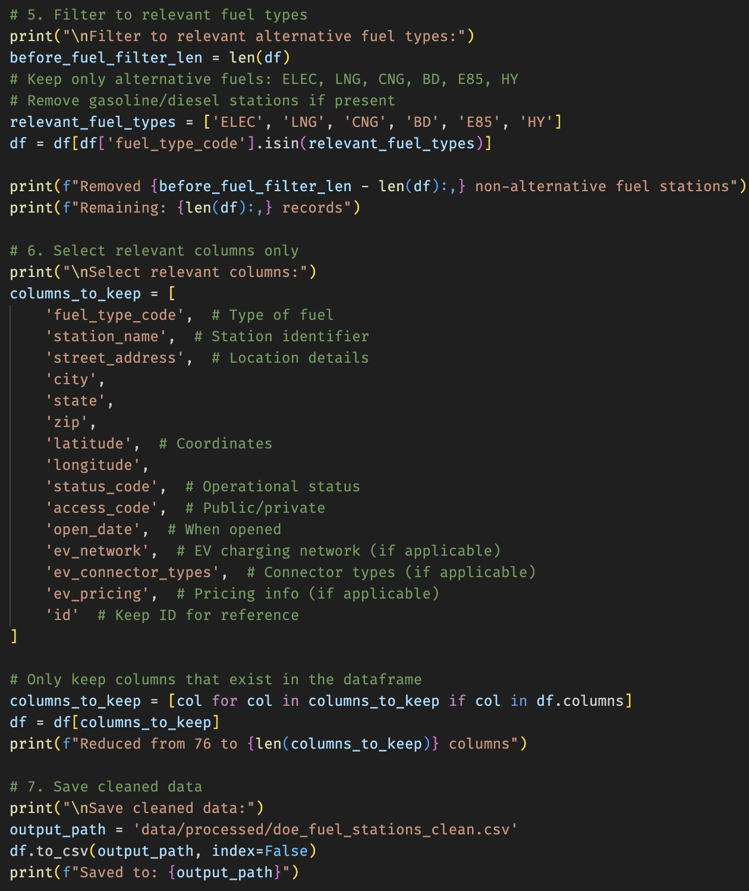
Data Processing – Cleaning & Preparation
DOE Fuel Stations – Processing & Cleaning
Raw data
Source: NREL “Alternative Fuel Stations” API → alt_fuel_stations.csv
~76 columns per station
Critical filters & location sanity checks
Drop rows missing: latitude, longitude, fuel_type_code, status_code
Remove coordinates outside assumed US bounds:
Latitude between 18 and 72
Longitude between –180 and –65
Remove exact (0, 0) coordinates
Duplicates & fuel-type filtering
Drop exact duplicates by NREL id
Keep only alternative fuels:
ELEC, LNG, CNG, BD, E85, HY
Column reduction & output
Reduce from ~76 columns to a focused subset:
fuel type, station name, address, state, coordinates, status, access type, EV network info
Save to data/processed/doe_fuel_stations_clean.csv
Notes:
Finally, for the DOE dataset, the goal was to clean the alternative fuel stations in a way that makes them reliable for national infrastructure analysis.
I start from the CSV exported from the NREL API, which contains around 76 columns per station. The first step is to drop rows that are missing critical fields: latitude, longitude, fuel type, or status. Without those, we can’t geolocate the station or understand whether it’s in operation, so those records are removed.
Next, I perform geographic sanity checks. I restrict the coordinates to a latitude between 18 and 72 degrees and a longitude between –180 and –65. These bounds are chosen to comfortably cover the United States including Alaska and Hawaii, while still catching obvious data-entry errors far outside the country. I also remove stations located exactly at coordinate (0, 0), which is a common placeholder or error value.
After that, I remove duplicate stations based on the unique id provided by the NREL API. This guarantees that each physical station appears only once in the cleaned dataset.
Then I filter down to the relevant alternative fuels: electricity, LNG, CNG, biodiesel, E85, and hydrogen. If any purely gasoline or diesel entries appear in the raw file, they are excluded at this stage because they are not meaningful for alternative fuel infrastructure analysis.
Finally, I reduce the number of columns to a focused subset: fuel type, station name, address, state, coordinates, status, access type, and EV network–related fields, when available. The cleaned result is saved as doe_fuel_stations_clean.csv and this becomes the input for the infrastructure metrics in the integration step.
The idea is to keep the DOE dataset lean, geographically valid, and focused strictly on the alternative fuels we care about.

Slide 13

Data Integration & Analytics Datasets
Why Integrate Datasets?
3 cleaned datasets → First step
EPA = fuel economy
NHTSA = reliability & safety
DOE = fuel infrastructure
Although cleaned, it’s possible to answer strategic questions with integrations
Integration creates business value
Connect fuel efficiency ↔ reliability
Connect vehicle demand ↔ infrastructure availability
Enable end-to-end insights for automotive strategy
Three purpose-built outputs
Vehicle Complaints Analysis
Fuel Infrastructure Analysis
Comprehensive Vehicle Analysis
Notes:
Data integration is what actually transforms these three datasets into business value. Individually, EPA, NHTSA, and DOE all answer isolated questions — fuel economy, complaints, and infrastructure — but none of them create insight on their own. By integrating them, we connect performance, reliability, and real-world usability. That’s what matters for an automotive supplier: understanding not just the vehicle, but how it behaves, how customers experience it, and whether the infrastructure supports it.
To keep this actionable, I didn’t build one giant dataset — I built three purpose-built outputs, each answering a different strategic question:
Vehicle Complaints Analysis (EPA + NHTSA) Built to understand reliability in the context of fuel economy. It answers: – Which vehicles are efficient and reliable? – Are EVs experiencing fewer complaints? – What models have high complaint rates or safety signals?
Fuel Infrastructure Analysis (EPA + DOE) Built to quantify infrastructure readiness for each fuel type. It answers: – Are there enough charging stations or alternative fuel stations? – Which fuels have the worst coverage? – How infrastructure evolves across years.
Comprehensive Vehicle Analysis (EPA + NHTSA + DOE) Built to tie all three perspectives together. It answers: – Does poor infrastructure correlate with more complaints? – Which vehicle segments offer the best opportunities: efficient, reliable, and well-supported? – Where are the gaps in the market?
So the value comes from connecting these datasets in a structured way, and the three outputs exist because each one supports a different layer of decision-making.”

Slide 14
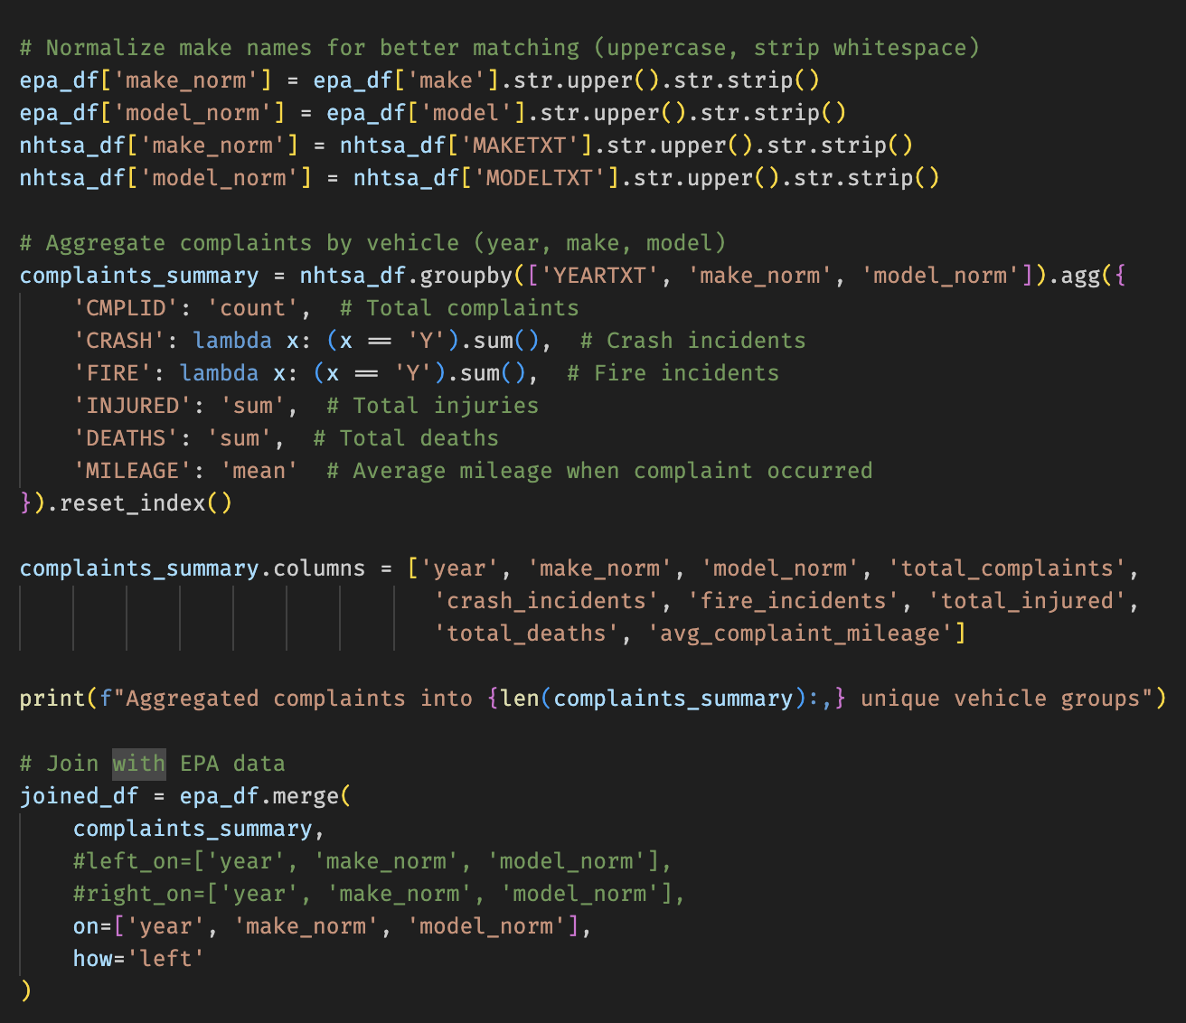
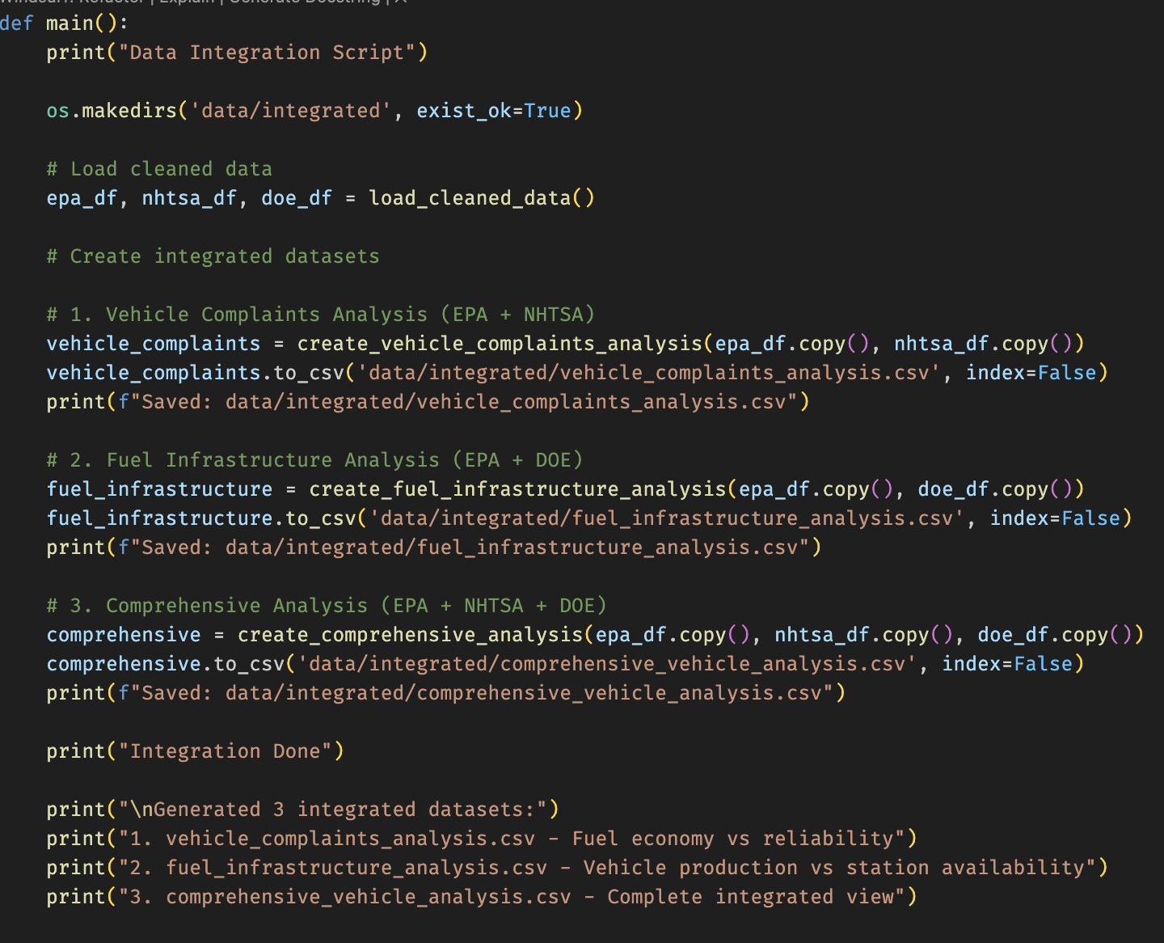
Data Integration & Analytics Datasets
Coding Process
1. vehicle_complaints_analysis.csv (EPA + NHTSA)
Normalize make / model (uppercase + trim)
Aggregate complaints per (year, make, model):
total_complaints, crash_incidents, fire_incidents
total_injured, total_deaths, avg_complaint_mileage
Left join onto EPA vehicles (incl. dual-fuel expansion)
Add vehicle_variants = count of EPA rows per (year, make, model)
2. fuel_infrastructure_analysis.csv (EPA + DOE)
Map EPA fuel_used → DOE fuel_type_code
Group by (year, fuel_type_code):
vehicle_count
average MPG (avg_combined_mpg, avg_city_mpg, avg_highway_mpg)
Aggregate DOE stations per fuel_type_code (nationwide)
Compute vehicles_per_station per fuel type and year
3. comprehensive_vehicle_analysis.csv (EPA + NHTSA + DOE)
Start from vehicle_complaints_analysis
Map fuel_used → fuel_type_code
Join DOE station counts (stations_nationwide) by fuel_type_code
One row per vehicle × fuel combination, with:
fuel economy, complaints, and infrastructure together
Notes:
You’ve seen how each of the three datasets is cleaned independently. Now I’ll show how they are integrated into three analytical outputs.
The first dataset is vehicle_complaints_analysis.csv, which joins EPA vehicles with NHTSA complaints to relate fuel economy and reliability.
To make the join robust, I create normalized keys: make_norm and model_norm, which are simply the uppercased and trimmed versions of the make and model for both EPA and NHTSA. On the NHTSA side, I then aggregate complaints per (year, make_norm, model_norm).
In that aggregation I compute:
the total number of complaints,
the number of crash-related and fire-related complaints,
the total injured and deaths,
and the average mileage at which the complaint occurred.
This aggregated table is then left-joined back onto the EPA vehicles dataset. Using a left join ensures that every EPA vehicle remains in the output, even if it has zero recorded complaints. For vehicles with no matching complaints, I fill the complaint metrics with zero.
After that, I compute a vehicle_variants column, which counts how many EPA rows exist for each (year, make, model) combination. This is useful to understand how many different configurations share the same model name. The end result is a dataset where each row is a vehicle–fuel combination, enriched with safety metrics.
The second dataset is fuel_infrastructure_analysis.csv, which combines EPA vehicles with DOE fuel stations to analyze infrastructure availability.
Here I use the fuel_used column from the EPA processing step, and map each descriptive fuel name to a DOE fuel_type_code such as ELEC, E85, CNG, or HY. Then I group by (year, fuel_type_code) to calculate the number of vehicle–fuel combinations and the average fuel economy metrics — combined, city, and highway MPG.
On the DOE side, I aggregate station counts per fuel_type_code across all states, including total stations and available stations. After joining those station counts with the vehicle counts, I compute a vehicles_per_station ratio. This metric gives a quick sense of how much vehicle demand exists per station for each fuel type and year.
Finally, the third dataset is comprehensive_vehicle_analysis.csv, which brings all three sources together.
I start from the vehicle–complaints dataset and again map fuel_used to fuel_type_code. I then join a simplified station count per fuel type, stations_nationwide, derived from the DOE data. The result is a comprehensive table where each row represents a specific vehicle–fuel combination, with its fuel economy, complaint history, and an indicator of how much infrastructure exists for that fuel.
These three integrated datasets form the analytical core of the project and are the basis for any downstream dashboards or further analysis.

Slide 15

Data Loading – Databricks (Simulated)
Simulation process
Goal
Load the 3 integrated CSVs into Delta tables for analytics
Target
Catalog: automative_data
Schema: analytics
Tables:
vehicle_complaints_analysis
fuel_infrastructure_analysis
comprehensive_vehicle_analysis
Strategy – Full Refresh
CREATE OR REPLACE TABLE per dataset
COPY INTO from /dbfs/mnt/staging/*.csv
Then OPTIMIZE + ANALYZE TABLE (compaction + stats)
Notes:
For the loading phase, I simulate pushing the three integrated CSVs into Databricks Delta Lake.
I chose Delta Lake because it's a very good fit for analytics: it gives ACID guarantees, automatic versioning, fast reads, and it integrates naturally with Spark and Databricks notebooks.
I load the tables under a specific catalog and schema—in this case automotive_data.analytics. The catalog is basically the high-level container, and the schema organizes the tables logically. So after the load, anyone querying analytics data can just run SELECT * FROM automotive_data.analytics.vehicle_complaints_analysis.
The strategy here is full refresh: recreate each table and reload all rows from the integrated CSVs. After loading, I run OPTIMIZE.
A simple example of what OPTIMIZE does: if a dataset gets written as hundreds of small files, OPTIMIZE compacts them into a few large files. This makes queries much faster because Spark has fewer files to scan.
So this part ensures we end up with clean, query-efficient Delta tables ready for analytics.

Slide 16
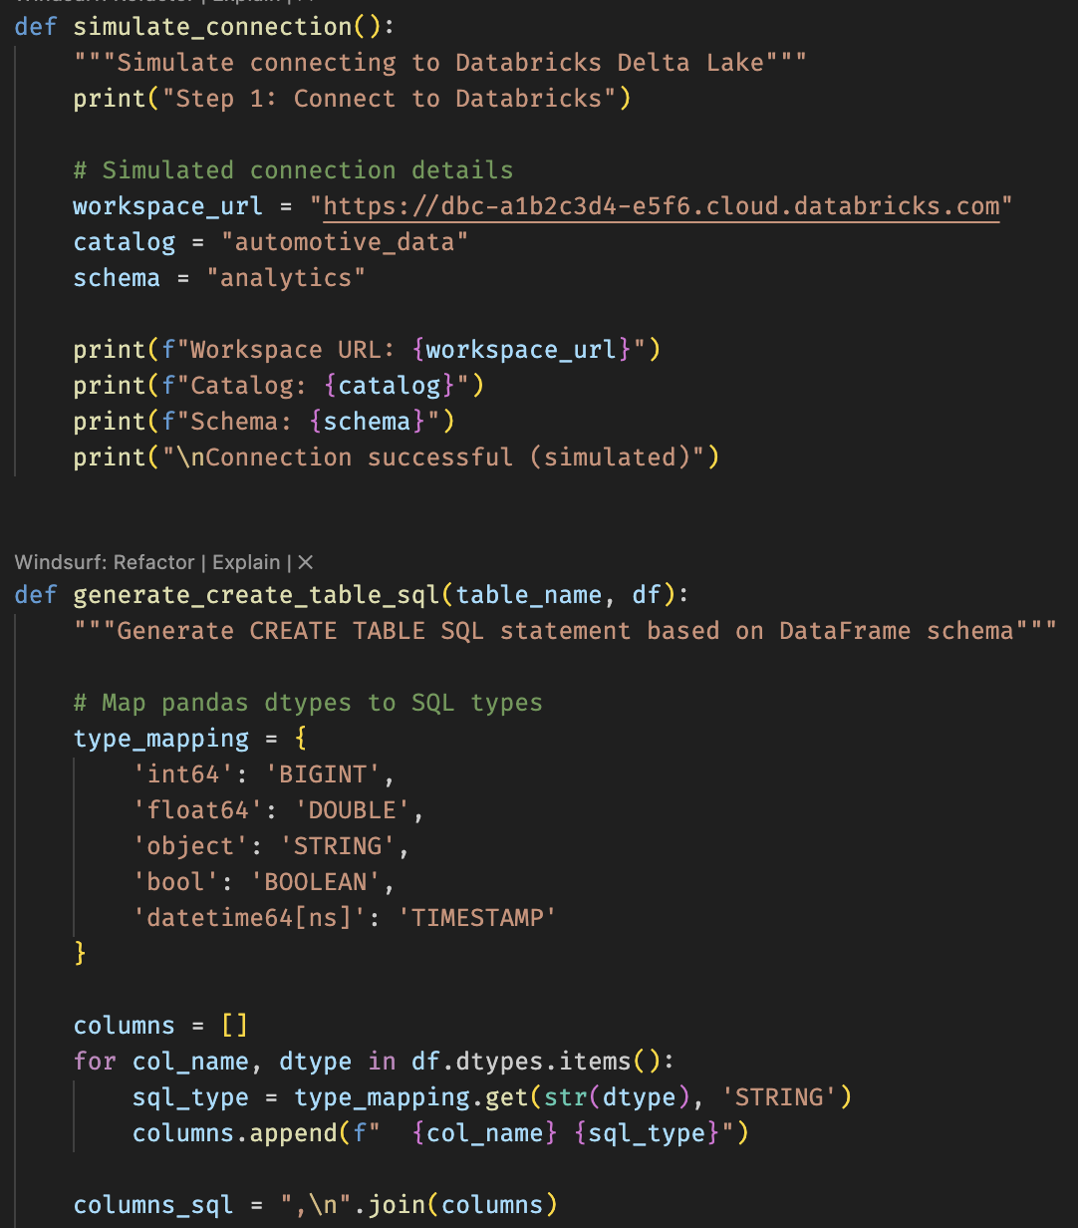
Data Loading – Databricks (Simulated)
Simulation process
What the script actually does
Inspects CSV schema with pandas
Generates CREATE TABLE DDL dynamically from dtypes
Prints the SQL and “loads” each dataset (simulated)
Simulates optimization and shows record counts per table
Notes:
Since I can’t connect to a real Databricks workspace here, the script reproduces what the loading process would do.
It reads each CSV with pandas to detect the schema, then dynamically generates the exact CREATE TABLE command that Delta Lake would use. It also prints the COPY INTO commands that would load the files into the Delta tables inside the automotive_data.analytics schema.
After that, it simulates the OPTIMIZE step and prints how many records each table would contain.
So the script doesn’t actually push data to Databricks—but it mirrors the real workflow that a Delta-based pipeline would use.

Slide 17
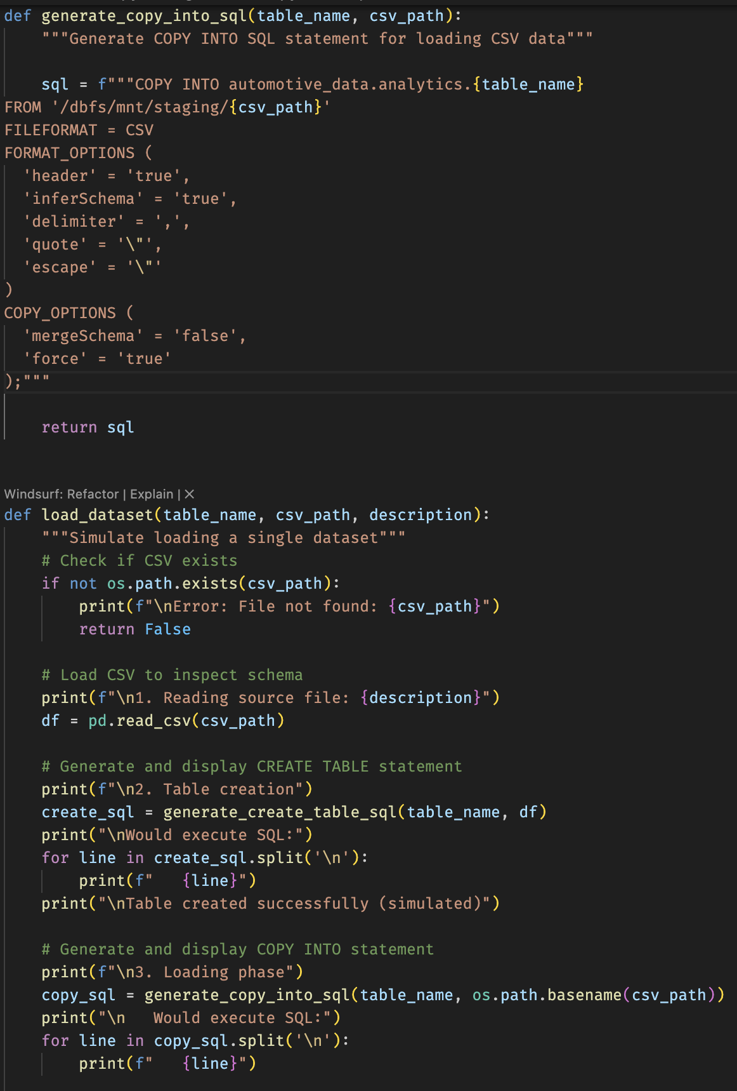
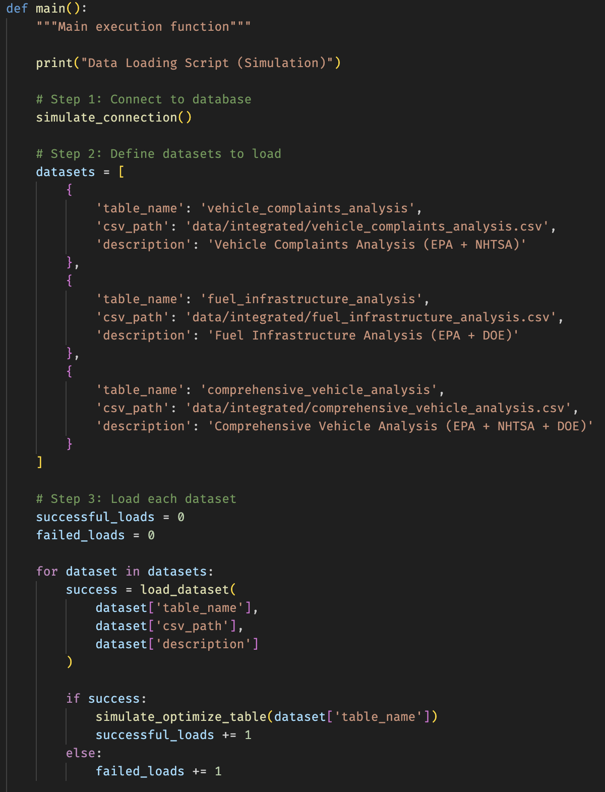
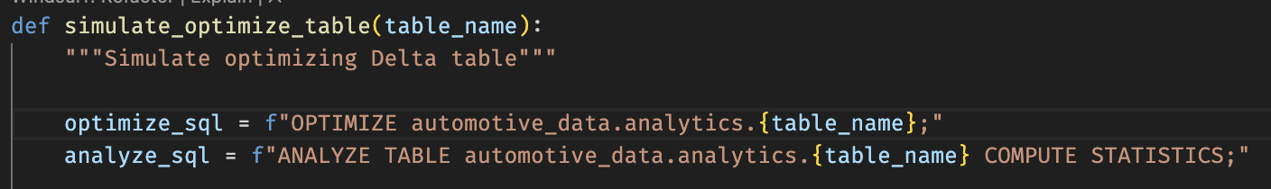
Data Loading – Databricks (Simulated)
Simulation process
Notes:
Since I can’t connect to a real Databricks workspace here, the script reproduces what the loading process would do.
It reads each CSV with pandas to detect the schema, then dynamically generates the exact CREATE TABLE command that Delta Lake would use. It also prints the COPY INTO commands that would load the files into the Delta tables inside the automotive_data.analytics schema.
After that, it simulates the OPTIMIZE step and prints how many records each table would contain.
So the script doesn’t actually push data to Databricks—but it mirrors the real workflow that a Delta-based pipeline would use.

Slide 18
Final Datasets Overview (Results)
Vehicle Complaints Analysis (EPA + NHTSA)
Purpose: Combine efficiency + reliability into one dataset
Answers:
Are efficient vehicles more reliable?
Which brands/models have high complaint rates?
Are EVs reporting fewer issues?
Results:
Efficient vehicles do not have fewer complaints. No correlation
EVs have 71.7% fewer complaints than gasoline cars
Most problematic brands per vehicle:
Chrysler, Honda, Hyundai, Kia and Dodge
Business Value: Highlights safety risks and brand reliability
Notes:
You’ve seen how each of the three datasets is cleaned independently. Now I’ll show how they are integrated into three analytical outputs.
The first dataset is vehicle_complaints_analysis.csv, which joins EPA vehicles with NHTSA complaints to relate fuel economy and reliability.
To make the join robust, I create normalized keys: make_norm and model_norm, which are simply the uppercased and trimmed versions of the make and model for both EPA and NHTSA. On the NHTSA side, I then aggregate complaints per (year, make_norm, model_norm).
In that aggregation I compute:
the total number of complaints,
the number of crash-related and fire-related complaints,
the total injured and deaths,
and the average mileage at which the complaint occurred.
This aggregated table is then left-joined back onto the EPA vehicles dataset. Using a left join ensures that every EPA vehicle remains in the output, even if it has zero recorded complaints. For vehicles with no matching complaints, I fill the complaint metrics with zero.
After that, I compute a vehicle_variants column, which counts how many EPA rows exist for each (year, make, model) combination. This is useful to understand how many different configurations share the same model name. The end result is a dataset where each row is a vehicle–fuel combination, enriched with safety metrics.
The second dataset is fuel_infrastructure_analysis.csv, which combines EPA vehicles with DOE fuel stations to analyze infrastructure availability.
Here I use the fuel_used column from the EPA processing step, and map each descriptive fuel name to a DOE fuel_type_code such as ELEC, E85, CNG, or HY. Then I group by (year, fuel_type_code) to calculate the number of vehicle–fuel combinations and the average fuel economy metrics — combined, city, and highway MPG.
On the DOE side, I aggregate station counts per fuel_type_code across all states, including total stations and available stations. After joining those station counts with the vehicle counts, I compute a vehicles_per_station ratio. This metric gives a quick sense of how much vehicle demand exists per station for each fuel type and year.
Finally, the third dataset is comprehensive_vehicle_analysis.csv, which brings all three sources together.
I start from the vehicle–complaints dataset and again map fuel_used to fuel_type_code. I then join a simplified station count per fuel type, stations_nationwide, derived from the DOE data. The result is a comprehensive table where each row represents a specific vehicle–fuel combination, with its fuel economy, complaint history, and an indicator of how much infrastructure exists for that fuel.
These three integrated datasets form the analytical core of the project and are the basis for any downstream dashboards or further analysis.

Slide 19
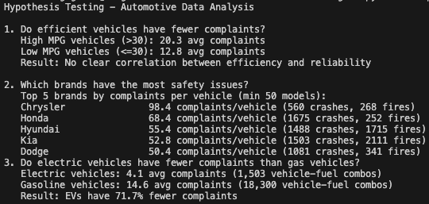
Final Datasets Overview (Results)
Vehicle Complaints Analysis (EPA + NHTSA)
Notes:
You’ve seen how each of the three datasets is cleaned independently. Now I’ll show how they are integrated into three analytical outputs.
The first dataset is vehicle_complaints_analysis.csv, which joins EPA vehicles with NHTSA complaints to relate fuel economy and reliability.
To make the join robust, I create normalized keys: make_norm and model_norm, which are simply the uppercased and trimmed versions of the make and model for both EPA and NHTSA. On the NHTSA side, I then aggregate complaints per (year, make_norm, model_norm).
In that aggregation I compute:
the total number of complaints,
the number of crash-related and fire-related complaints,
the total injured and deaths,
and the average mileage at which the complaint occurred.
This aggregated table is then left-joined back onto the EPA vehicles dataset. Using a left join ensures that every EPA vehicle remains in the output, even if it has zero recorded complaints. For vehicles with no matching complaints, I fill the complaint metrics with zero.
After that, I compute a vehicle_variants column, which counts how many EPA rows exist for each (year, make, model) combination. This is useful to understand how many different configurations share the same model name. The end result is a dataset where each row is a vehicle–fuel combination, enriched with safety metrics.
The second dataset is fuel_infrastructure_analysis.csv, which combines EPA vehicles with DOE fuel stations to analyze infrastructure availability.
Here I use the fuel_used column from the EPA processing step, and map each descriptive fuel name to a DOE fuel_type_code such as ELEC, E85, CNG, or HY. Then I group by (year, fuel_type_code) to calculate the number of vehicle–fuel combinations and the average fuel economy metrics — combined, city, and highway MPG.
On the DOE side, I aggregate station counts per fuel_type_code across all states, including total stations and available stations. After joining those station counts with the vehicle counts, I compute a vehicles_per_station ratio. This metric gives a quick sense of how much vehicle demand exists per station for each fuel type and year.
Finally, the third dataset is comprehensive_vehicle_analysis.csv, which brings all three sources together.
I start from the vehicle–complaints dataset and again map fuel_used to fuel_type_code. I then join a simplified station count per fuel type, stations_nationwide, derived from the DOE data. The result is a comprehensive table where each row represents a specific vehicle–fuel combination, with its fuel economy, complaint history, and an indicator of how much infrastructure exists for that fuel.
These three integrated datasets form the analytical core of the project and are the basis for any downstream dashboards or further analysis.

Slide 20
Final Datasets Overview (Results)
Fuel Infrastructure Analysis (EPA + DOE)
Purpose: Connect vehicle production (EPA) with national fuel station availability (DOE) to understand infrastructure readiness.
Answers:
Are alternative fuel vehicles supported by enough stations?
Which fuel types are most infrastructure-constrained?
How many vehicles exist per station by fuel type?
Results:
All analyzed fuel types (HY, BD, ELEC) exceed infrastructure threshold
Electric infrastructure is extremely dense: ~292,366 stations per 1,000 vehicles
Biodiesel and Hydrogen also show no shortages in this dataset
Business Value: Shows whether the national infrastructure can support growth in alternative fuel vehicles and identifies where strategic investments are or are not necessary.
Notes:
You’ve seen how each of the three datasets is cleaned independently. Now I’ll show how they are integrated into three analytical outputs.
The first dataset is vehicle_complaints_analysis.csv, which joins EPA vehicles with NHTSA complaints to relate fuel economy and reliability.
To make the join robust, I create normalized keys: make_norm and model_norm, which are simply the uppercased and trimmed versions of the make and model for both EPA and NHTSA. On the NHTSA side, I then aggregate complaints per (year, make_norm, model_norm).
In that aggregation I compute:
the total number of complaints,
the number of crash-related and fire-related complaints,
the total injured and deaths,
and the average mileage at which the complaint occurred.
This aggregated table is then left-joined back onto the EPA vehicles dataset. Using a left join ensures that every EPA vehicle remains in the output, even if it has zero recorded complaints. For vehicles with no matching complaints, I fill the complaint metrics with zero.
After that, I compute a vehicle_variants column, which counts how many EPA rows exist for each (year, make, model) combination. This is useful to understand how many different configurations share the same model name. The end result is a dataset where each row is a vehicle–fuel combination, enriched with safety metrics.
The second dataset is fuel_infrastructure_analysis.csv, which combines EPA vehicles with DOE fuel stations to analyze infrastructure availability.
Here I use the fuel_used column from the EPA processing step, and map each descriptive fuel name to a DOE fuel_type_code such as ELEC, E85, CNG, or HY. Then I group by (year, fuel_type_code) to calculate the number of vehicle–fuel combinations and the average fuel economy metrics — combined, city, and highway MPG.
On the DOE side, I aggregate station counts per fuel_type_code across all states, including total stations and available stations. After joining those station counts with the vehicle counts, I compute a vehicles_per_station ratio. This metric gives a quick sense of how much vehicle demand exists per station for each fuel type and year.
Finally, the third dataset is comprehensive_vehicle_analysis.csv, which brings all three sources together.
I start from the vehicle–complaints dataset and again map fuel_used to fuel_type_code. I then join a simplified station count per fuel type, stations_nationwide, derived from the DOE data. The result is a comprehensive table where each row represents a specific vehicle–fuel combination, with its fuel economy, complaint history, and an indicator of how much infrastructure exists for that fuel.
These three integrated datasets form the analytical core of the project and are the basis for any downstream dashboards or further analysis.

Slide 21
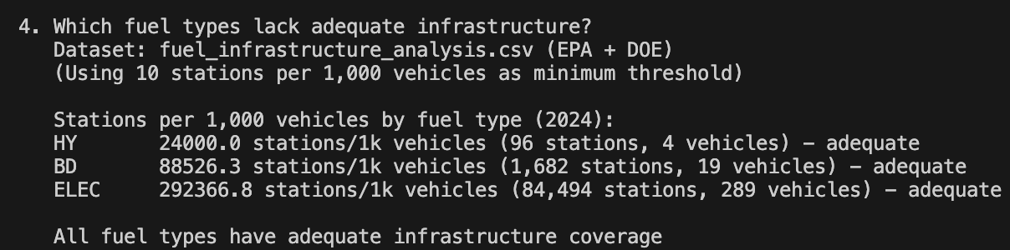
Final Datasets Overview (Results)
Fuel Infrastructure Analysis (EPA + DOE)
Notes:
You’ve seen how each of the three datasets is cleaned independently. Now I’ll show how they are integrated into three analytical outputs.
The first dataset is vehicle_complaints_analysis.csv, which joins EPA vehicles with NHTSA complaints to relate fuel economy and reliability.
To make the join robust, I create normalized keys: make_norm and model_norm, which are simply the uppercased and trimmed versions of the make and model for both EPA and NHTSA. On the NHTSA side, I then aggregate complaints per (year, make_norm, model_norm).
In that aggregation I compute:
the total number of complaints,
the number of crash-related and fire-related complaints,
the total injured and deaths,
and the average mileage at which the complaint occurred.
This aggregated table is then left-joined back onto the EPA vehicles dataset. Using a left join ensures that every EPA vehicle remains in the output, even if it has zero recorded complaints. For vehicles with no matching complaints, I fill the complaint metrics with zero.
After that, I compute a vehicle_variants column, which counts how many EPA rows exist for each (year, make, model) combination. This is useful to understand how many different configurations share the same model name. The end result is a dataset where each row is a vehicle–fuel combination, enriched with safety metrics.
The second dataset is fuel_infrastructure_analysis.csv, which combines EPA vehicles with DOE fuel stations to analyze infrastructure availability.
Here I use the fuel_used column from the EPA processing step, and map each descriptive fuel name to a DOE fuel_type_code such as ELEC, E85, CNG, or HY. Then I group by (year, fuel_type_code) to calculate the number of vehicle–fuel combinations and the average fuel economy metrics — combined, city, and highway MPG.
On the DOE side, I aggregate station counts per fuel_type_code across all states, including total stations and available stations. After joining those station counts with the vehicle counts, I compute a vehicles_per_station ratio. This metric gives a quick sense of how much vehicle demand exists per station for each fuel type and year.
Finally, the third dataset is comprehensive_vehicle_analysis.csv, which brings all three sources together.
I start from the vehicle–complaints dataset and again map fuel_used to fuel_type_code. I then join a simplified station count per fuel type, stations_nationwide, derived from the DOE data. The result is a comprehensive table where each row represents a specific vehicle–fuel combination, with its fuel economy, complaint history, and an indicator of how much infrastructure exists for that fuel.
These three integrated datasets form the analytical core of the project and are the basis for any downstream dashboards or further analysis.

Slide 22
Final Datasets Overview (Results)
Comprehensive Vehicle Analysis (EPA + NHTSA + DOE)
Purpose: Provide a full end-to-end view combining economy, reliability, and infrastructure for strategic insights.
Answers:
Do vehicles with poor infrastructure receive more complaints?
Which vehicle classes offer the best balance of efficiency + reliability?
Are infrastructure gaps affecting customer experience?
Results:
Vehicles with poor infrastructure have 252% more complaints
EVs: low complaints + strong infrastructure
Most efficient classes:
Small Station Wagons
Small SUVs 2WD
Midsize Cars
Most reliable classes:
Small Pickup Trucks
Standard Pickup Trucks
Cargo & Passenger Vans
Business Value: Shows whether the national infrastructure can support growth in alternative fuel vehicles and identifies where strategic investments are or are not necessary.
Notes:
You’ve seen how each of the three datasets is cleaned independently. Now I’ll show how they are integrated into three analytical outputs.
The first dataset is vehicle_complaints_analysis.csv, which joins EPA vehicles with NHTSA complaints to relate fuel economy and reliability.
To make the join robust, I create normalized keys: make_norm and model_norm, which are simply the uppercased and trimmed versions of the make and model for both EPA and NHTSA. On the NHTSA side, I then aggregate complaints per (year, make_norm, model_norm).
In that aggregation I compute:
the total number of complaints,
the number of crash-related and fire-related complaints,
the total injured and deaths,
and the average mileage at which the complaint occurred.
This aggregated table is then left-joined back onto the EPA vehicles dataset. Using a left join ensures that every EPA vehicle remains in the output, even if it has zero recorded complaints. For vehicles with no matching complaints, I fill the complaint metrics with zero.
After that, I compute a vehicle_variants column, which counts how many EPA rows exist for each (year, make, model) combination. This is useful to understand how many different configurations share the same model name. The end result is a dataset where each row is a vehicle–fuel combination, enriched with safety metrics.
The second dataset is fuel_infrastructure_analysis.csv, which combines EPA vehicles with DOE fuel stations to analyze infrastructure availability.
Here I use the fuel_used column from the EPA processing step, and map each descriptive fuel name to a DOE fuel_type_code such as ELEC, E85, CNG, or HY. Then I group by (year, fuel_type_code) to calculate the number of vehicle–fuel combinations and the average fuel economy metrics — combined, city, and highway MPG.
On the DOE side, I aggregate station counts per fuel_type_code across all states, including total stations and available stations. After joining those station counts with the vehicle counts, I compute a vehicles_per_station ratio. This metric gives a quick sense of how much vehicle demand exists per station for each fuel type and year.
Finally, the third dataset is comprehensive_vehicle_analysis.csv, which brings all three sources together.
I start from the vehicle–complaints dataset and again map fuel_used to fuel_type_code. I then join a simplified station count per fuel type, stations_nationwide, derived from the DOE data. The result is a comprehensive table where each row represents a specific vehicle–fuel combination, with its fuel economy, complaint history, and an indicator of how much infrastructure exists for that fuel.
These three integrated datasets form the analytical core of the project and are the basis for any downstream dashboards or further analysis.

Slide 23
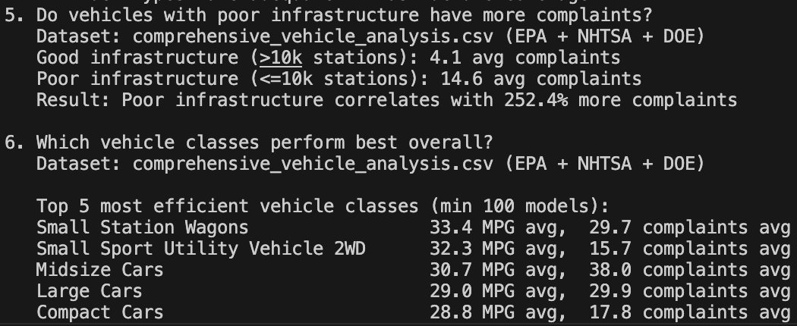
Final Datasets Overview (Results)
Comprehensive Vehicle Analysis (EPA + NHTSA + DOE)
Notes:
You’ve seen how each of the three datasets is cleaned independently. Now I’ll show how they are integrated into three analytical outputs.
The first dataset is vehicle_complaints_analysis.csv, which joins EPA vehicles with NHTSA complaints to relate fuel economy and reliability.
To make the join robust, I create normalized keys: make_norm and model_norm, which are simply the uppercased and trimmed versions of the make and model for both EPA and NHTSA. On the NHTSA side, I then aggregate complaints per (year, make_norm, model_norm).
In that aggregation I compute:
the total number of complaints,
the number of crash-related and fire-related complaints,
the total injured and deaths,
and the average mileage at which the complaint occurred.
This aggregated table is then left-joined back onto the EPA vehicles dataset. Using a left join ensures that every EPA vehicle remains in the output, even if it has zero recorded complaints. For vehicles with no matching complaints, I fill the complaint metrics with zero.
After that, I compute a vehicle_variants column, which counts how many EPA rows exist for each (year, make, model) combination. This is useful to understand how many different configurations share the same model name. The end result is a dataset where each row is a vehicle–fuel combination, enriched with safety metrics.
The second dataset is fuel_infrastructure_analysis.csv, which combines EPA vehicles with DOE fuel stations to analyze infrastructure availability.
Here I use the fuel_used column from the EPA processing step, and map each descriptive fuel name to a DOE fuel_type_code such as ELEC, E85, CNG, or HY. Then I group by (year, fuel_type_code) to calculate the number of vehicle–fuel combinations and the average fuel economy metrics — combined, city, and highway MPG.
On the DOE side, I aggregate station counts per fuel_type_code across all states, including total stations and available stations. After joining those station counts with the vehicle counts, I compute a vehicles_per_station ratio. This metric gives a quick sense of how much vehicle demand exists per station for each fuel type and year.
Finally, the third dataset is comprehensive_vehicle_analysis.csv, which brings all three sources together.
I start from the vehicle–complaints dataset and again map fuel_used to fuel_type_code. I then join a simplified station count per fuel type, stations_nationwide, derived from the DOE data. The result is a comprehensive table where each row represents a specific vehicle–fuel combination, with its fuel economy, complaint history, and an indicator of how much infrastructure exists for that fuel.
These three integrated datasets form the analytical core of the project and are the basis for any downstream dashboards or further analysis.

Slide 24

Automation Overview
Pipeline Automation – Azure Data Factory
Weekly automated pipeline (Sunday 02:00)
Orchestrates entire flow:
Acquisition -> Processing -> Integration -> Loading -> Validation
No manual steps
Ensures fresh, validated data weekly
Notes:
“For automation, I designed a simple weekly pipeline in Azure Data Factory. It runs every Sunday at 2AM and executes the entire workflow end-to-end — acquisition, processing, integration, loading, and validation — without any manual intervention.
The idea is to make the whole process reliable, repeatable, and always ready for Monday’s analysis.”

Slide 25

Automation Overview
Why Azure Data Factory
Native integration: Databricks + Storage + Key Vault
Visual pipeline design
Built-in scheduling & monitoring
Serverless (pay only when executing)
Durable & scalable
Notes:
I chose Azure Data Factory because it integrates natively with Databricks, Storage, and Key Vault. It gives visual pipeline design, built-in monitoring, retry logic, scheduling, and a serverless model — meaning we only pay when the pipeline actually runs.
It’s the most natural orchestration layer for this architecture.

Slide 26
Automation Overview
Why Azure Data Factory
5 sequential activities:
Acquire Data → raw files
Process Data → cleaned files
Integrate Data → final CSVs
Load to Delta Lake → 3 Delta tables
Validate → row counts & schema checks
Failure behavior:
Stops on error
Alerts via email
Notes:
“The pipeline itself has five activities. We acquire the data, process it, integrate it, load it into Delta tables, and validate everything at the end. Each activity waits for the previous one to succeed. If anything fails, the pipeline stops and sends an alert.
Even though this is simulated, the structure follows a real enterprise ADF workflow.”

Slide 27
Automation Overview
Why Azure Data Factory
Key Components:
Linked Services: Databricks, ADLS, Key Vault
Datasets: Raw → Processed → Integrated
Job Clusters: Auto-create & auto-terminate
Validation: Row counts + type checks
Notes:
These are the components behind the pipeline: linked services for Databricks, Storage, and Key Vault; datasets for each stage; and job clusters that auto-create and auto-terminate for cost control.”

Slide 28

Challenges Faced
Top Challenges Faced
Vehicle Matching Across Sources
Different naming conventions (F150 vs F-150)
No universal vehicle ID
Solution: Normalization + year/make/model join
Dual-Fuel Vehicles (Biggest Challenge)
Plug-in hybrids use two infrastructures
Solution: “Exploded rows” → one row per fuel type
Accurate EV + gasoline demand
Notes:
The two biggest challenges were matching vehicles across different sources and handling dual-fuel vehicles.
First, EPA, NHTSA and DOE use completely different naming conventions. There’s no universal vehicle ID. To solve this, I normalized all names and joined on year-make-model, accepting that some unmatched cases are normal because most vehicles genuinely have no complaints.
The second and biggest challenge was dual-fuel vehicles — like plug-in hybrids that require both gasoline and charging infrastructure. If I kept a single row, infrastructure demand would be wrong.
So I ‘exploded’ those vehicles into one row per fuel type. This makes counts accurate and keeps the analysis realistic.

